Slide 1
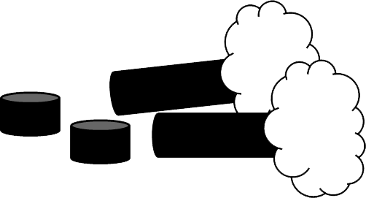
DEFORESTATION
Patrick

Slide 2
What is deforestation?
Deforestation is the removal of a forest of trees from a land that will be used for housing, farms or new roads.
Between 2000 and 2012, 2.3 million square kilometers of forests around the world were cut down.
About 31% of Earth's land surface is covered by forests.

Slide 3
Types of deforestation:
There are two kinds of deforestation:
Clear-cutting; most to all of the forest area is cut down with method.
Selective; Only the trees that are useful for the loggers are cut down when using this method.

Slide 4
Effects of deforestation
There are many effects of deforestation,here are a few:
Soil erosion destruction; Soil moisture is dried up with the sun as it now doesn't have the canopy for protection. The rain washes away the surface of the soil and erosion happens.
Loss of biodiversity; Many species of animal and plant have been lost. It is estimated that about 50 to 100 species of animals are being lost every day because their homes are being destroyed.
Climate change; Trees and plants absorb Carbon Dioxide CO2 from the atmosphere and produce Oxygen which we all, including plants need to live. Destroying the forests means that the CO2 remains in the atmosphere and that is very dangerous for every species that lives on Earth.

Slide 5
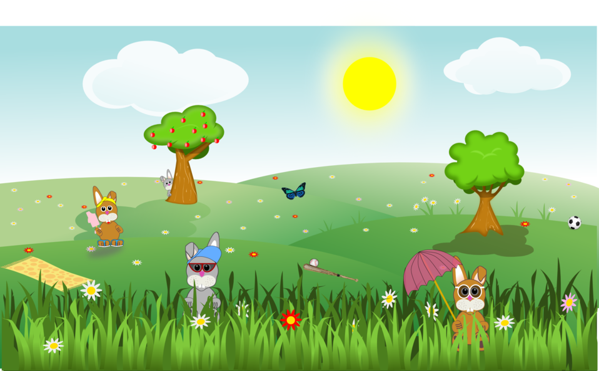
How can we stop deforestation?
We all can give a helping hand to help stop this; we should try some of these:
Plant a tree where you can.
Go paperless with your household/work bills and letters.
Buy recycled goods and use them again.
Support companies who are actively committed to deforestation.

