Slide 1
DEFORESTATION
BY NOAH MISKELLY

Slide 2
What is Deforestation ?
Deforestation is people cutting down trees and taking away animals habitats. People do not plant them again so deforestation occurs.
It is harder for people to breathe because we breathe in oxygen and breathe out carbon dioxide. Many animals also die from this.

Slide 3
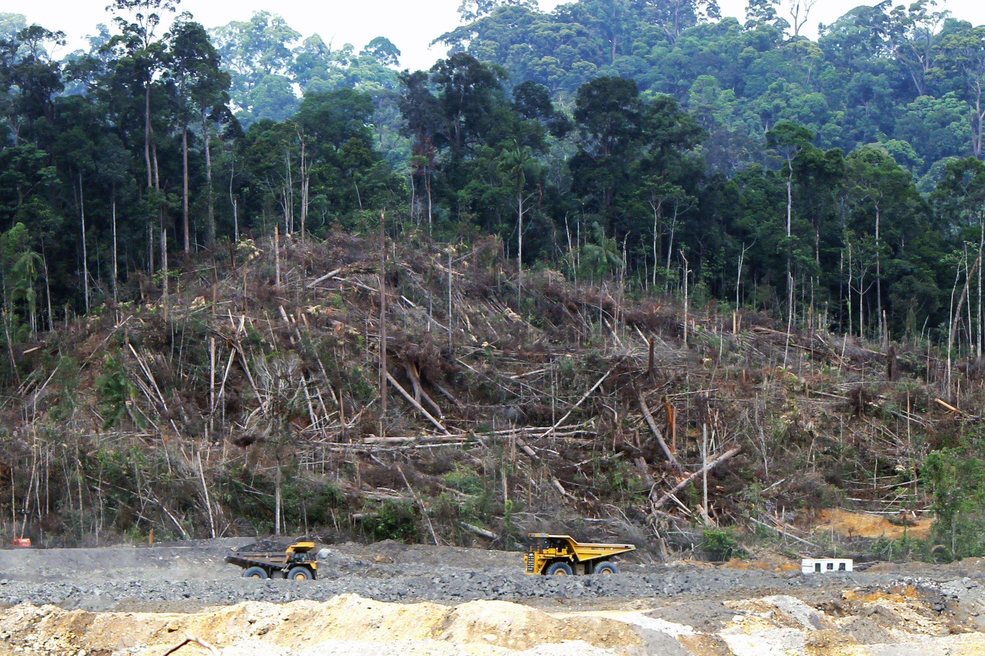
Types of Deforestation
There are 2 different types of deforestation.
CLEAR CUTTING - occurs when most or all of an entire area is taken down.
SELECTIVE LOGGING - loggers only cut down trees that are of use to them.

Slide 4
Effects of deforestation
Forests provide food and shelter for so much life on earth.
Millions of people rely directly on forests for their homes and furniture.
Animals also rely on forests for food and shelter.
Forest loss and damage is the cause of 10% of global warming.

Slide 5
How can we stop it
Plant a tree.
Go paperless at home.
Buy recycled products and recycle them again.
Buy certified wood products.
Buy only what you would use.
Do not buy meat products meat products sourced from land where forests have been cleared.

