Slide 1
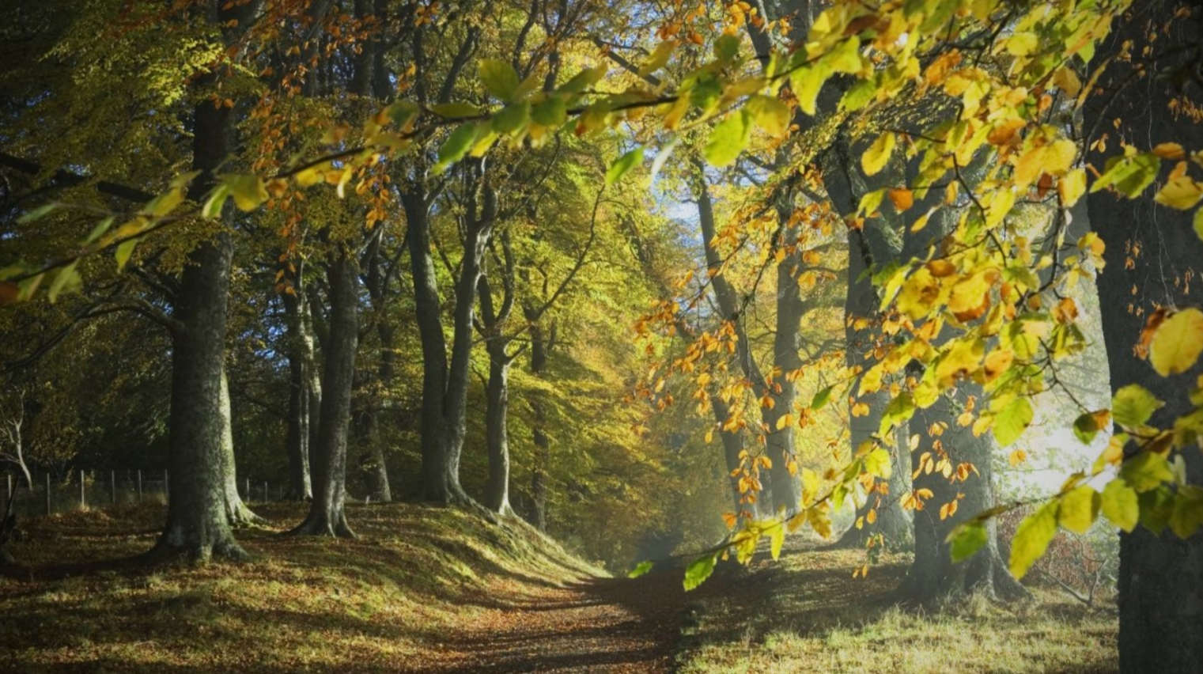
Deforestation
By Magdalena Kantorowicz

Slide 2
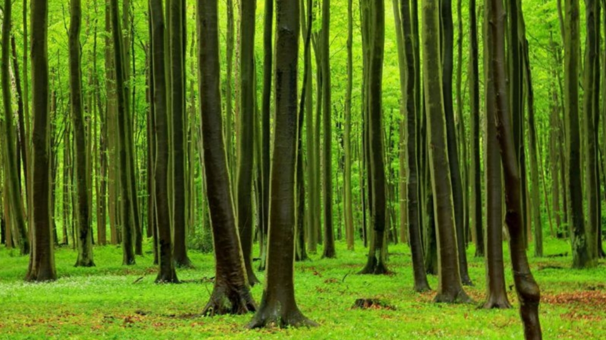
What is deforestation.
well deforestation is cuting down trees and making other things just like recycling another word for trees is wood and from wood we make all kinds of things for example we can make
Table,chair,desk,candle holderseck,patio,house,shed,chest,jewelry box,lamp base,serving spoon,oars,spatual,hockey sticks,baseball bats,fences,floors,paper,pencil,coat rack,door,wardrobe ,dresser,drums,violin,celo,drum sticks,fire wood,rular,birdhouses,coffin,porch swing,trunk,window frame,chopstick,cane,barrel,dog kennel,shutters thats some of the things that are made of wood .

Slide 3
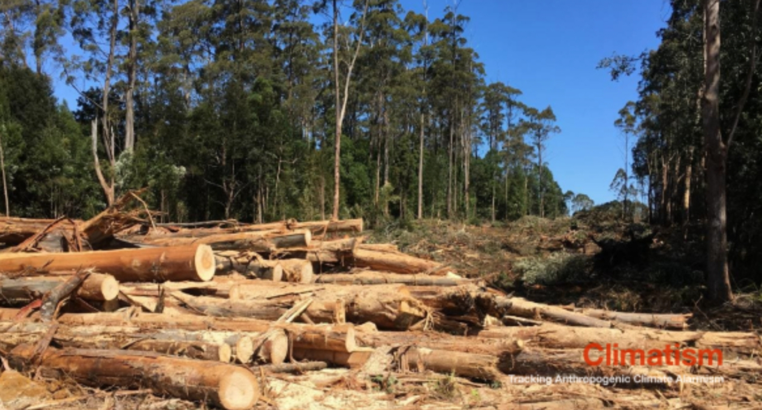
Types of deforestation.
There are two separate kinds of deforestation – clear-cutting and selective logging.Clear-cutting occurs when most or all of an entire area is taken down.While in selective logging,loggers only cut down the the trees that are of use to them.

Slide 4
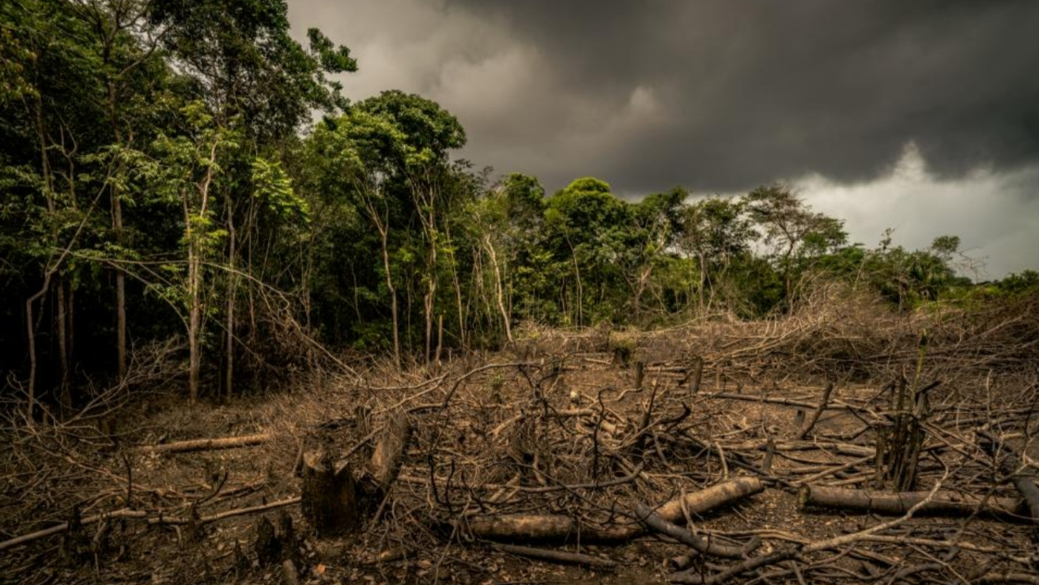
Effects of defrestation .
The loss of trees and other vegetation can cause climate change, desertification,soil erosion,fewer crops,flooding ,increased greenhouse gaeses in the atmasphene,and a host of problems for indigenous people.

Slide 5
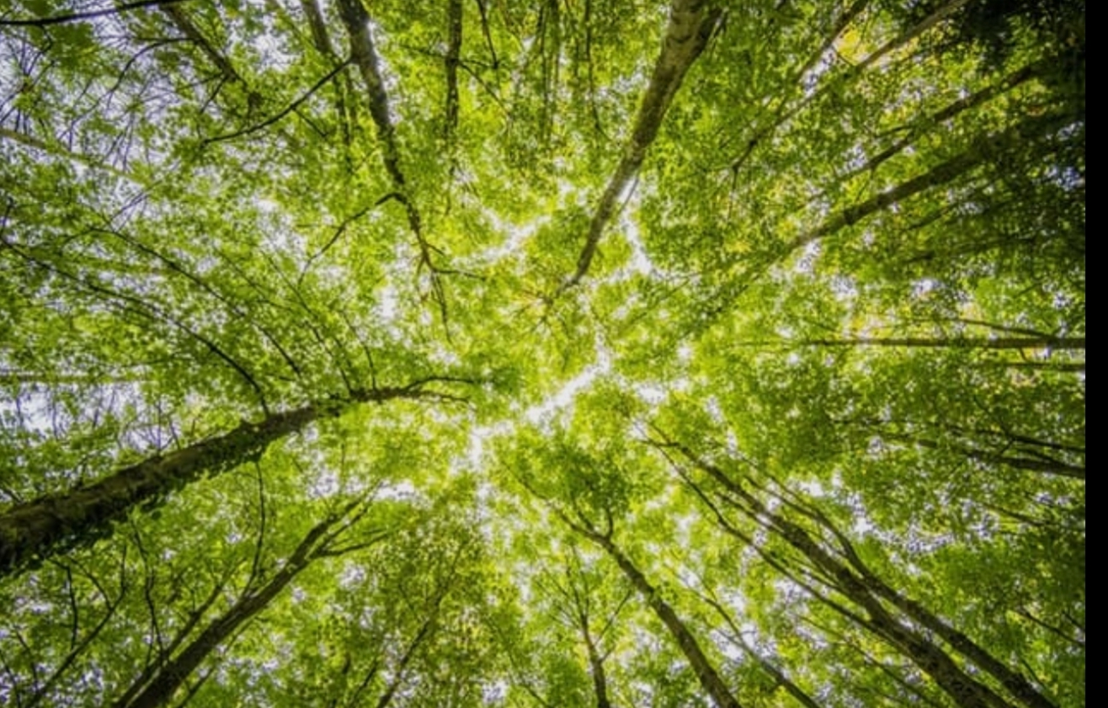
How can we stop deforestation.
You can contribute to the efforts againest deforestation by doing these easy step.
1. Plant a tree where u can.
2. Go paperless at home and in the office.
3. Buy recycled products and recycle them again.
4. Buy certified wood products. Read the lables and look for the FSC (Forest Stewarship Council) mark.
5. Suppport the products of companies that are committed to reducing deforestation. It’s all about business. If you dont buy, they will be encouraged to improve their practices.
6. Raise awareness in your circle and in your community.
7. Buy only what you will use .
8. Don’t use Palm Oil or products with Palm Oil.

Slide 6
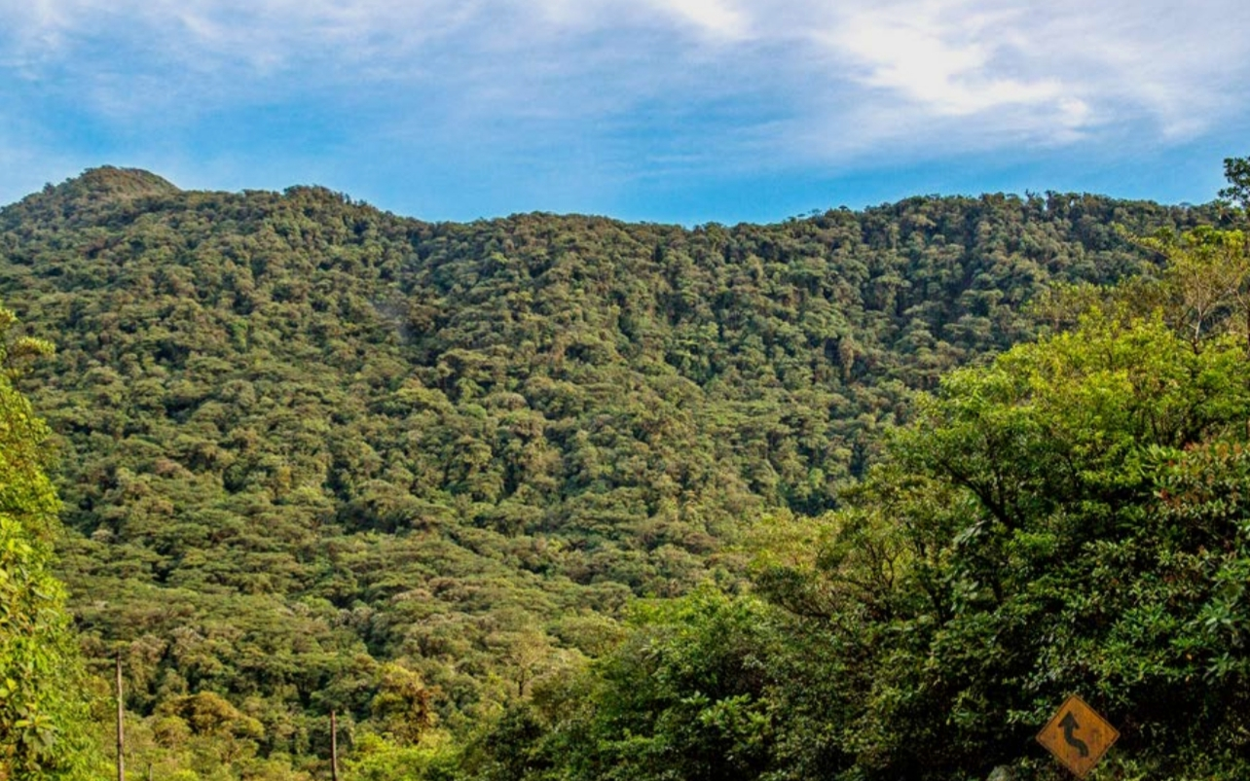
Extra information about deforestation.
1. Forests cover 30% of the earths land.
2.It is estimatd that within 100 years there will be no rainforests.
3.Agriculture is the leading cause of deforestation.
4.One and a half acres of forest is cut down every second.
5.The rate of deforestation equalsto loss of 20 football fields every minute.
6.If the current rate of deforestation continues, it will take less than 100 years to destroy all the rainforests on the earth.
7.There are more than 121 natural remedies in the rain forest which can be used as medicines.
8.20% of the worlds oxygen is pruduced in amazon forest.

Slide 7
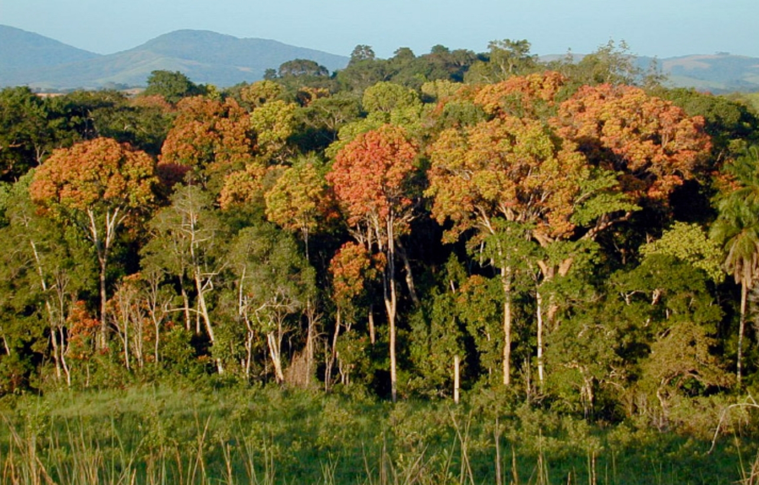
More extra information about deforestation
9.25% of cancers fighting organisms are found in the amazon.
10.Half of the worlds tropical foresthas already been cleared.
11.4500 acres of forests are cleared every hourby forest fires, bull dozers, machetes etc.
12.The total world forest loss till date 7.3 million hectares per year.
13.The United States has less that 5% of te worlds population but consumes more than 30% of the worlds pape.r
14.Trees are important constituents of the ecosystem by absorbing carbon.
15.Money to save trees is majorlycollected online.
16.The worlds forests store 283 billion tons of carbon present in the biomass.

Slide 8
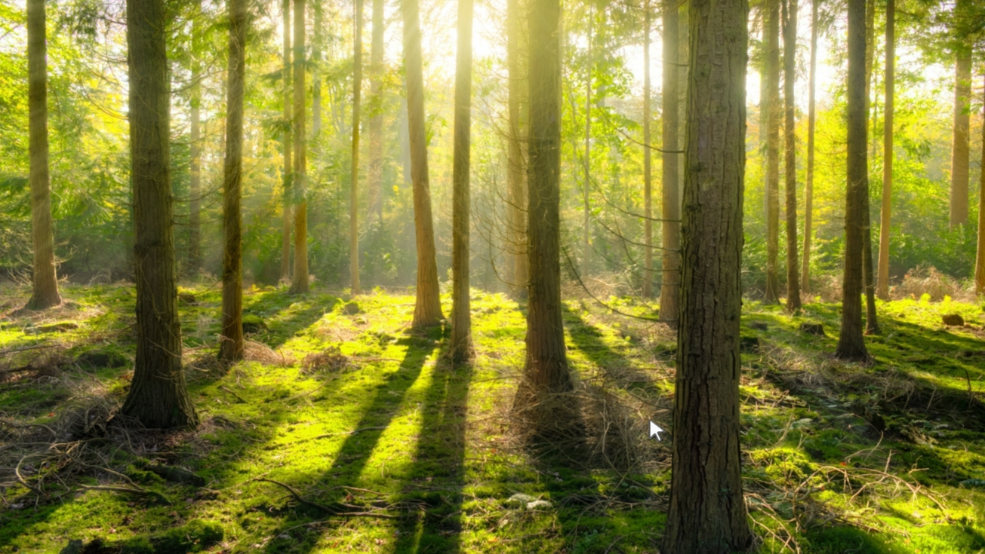
Thank You For Watching

