Slide 1
DEFORESTATION
Lucas O’Hagan

Slide 2
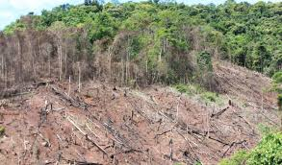
What is deforestation?
Deforestation is the clearing, or cutting down of forests. The word is normally used to describe the actions of humans in removing forests from the planet, rather than destruction caused by such natural events like hurricanes. People have been cutting down trees for THOUSANDS OF YEARS. … most deforestation is permanent. Experts estimate that about 500,000 square miles (1.3 million square kilometers) of land is deforested every 10 years. Half of the amazon rainforest is primary forest, which means it’s never been cut Down Before. The largest amount of deforestation is happening in tropical areas, where rainforests are being cut down. Some areas do recover from this damage, but it can take many years.

Slide 3
TYPES OF DEFORESTATION
There are 2 kinds of deforestation, clear cutting and selective logging.
Clear cutting occurs when most when most of a entire area is taken down.
In selective logging, loggers only cut down trees that are of use to them.

Slide 4
Effects of deforestation
The loss of trees and other vegetation can cause climate change, desertification, soil erosion, fewer crops, flooding, increased greenhouse gases in the atmosphere and a host of problems for indigenous people. Deforestation or felling trees has become a favourite activity of man to extract assorted needs, be it medicines or precious paper to waste. For obvious reasons, it is shameful to read the statistics on how discriminating man has been, especially when it comes to deforestation… But at the end there's always hope.

Slide 5
How can we stop this?
How we can stop this.
1. Plant a tree where you can.
2. Go paperless at home and office.
3. Buy recycled products then recycle them again after.
4. Buy certified wood products.
5. Support the products of companies that are committed to deforestation

