Slide 1
Deforestation
By Jay Elliott

Slide 2
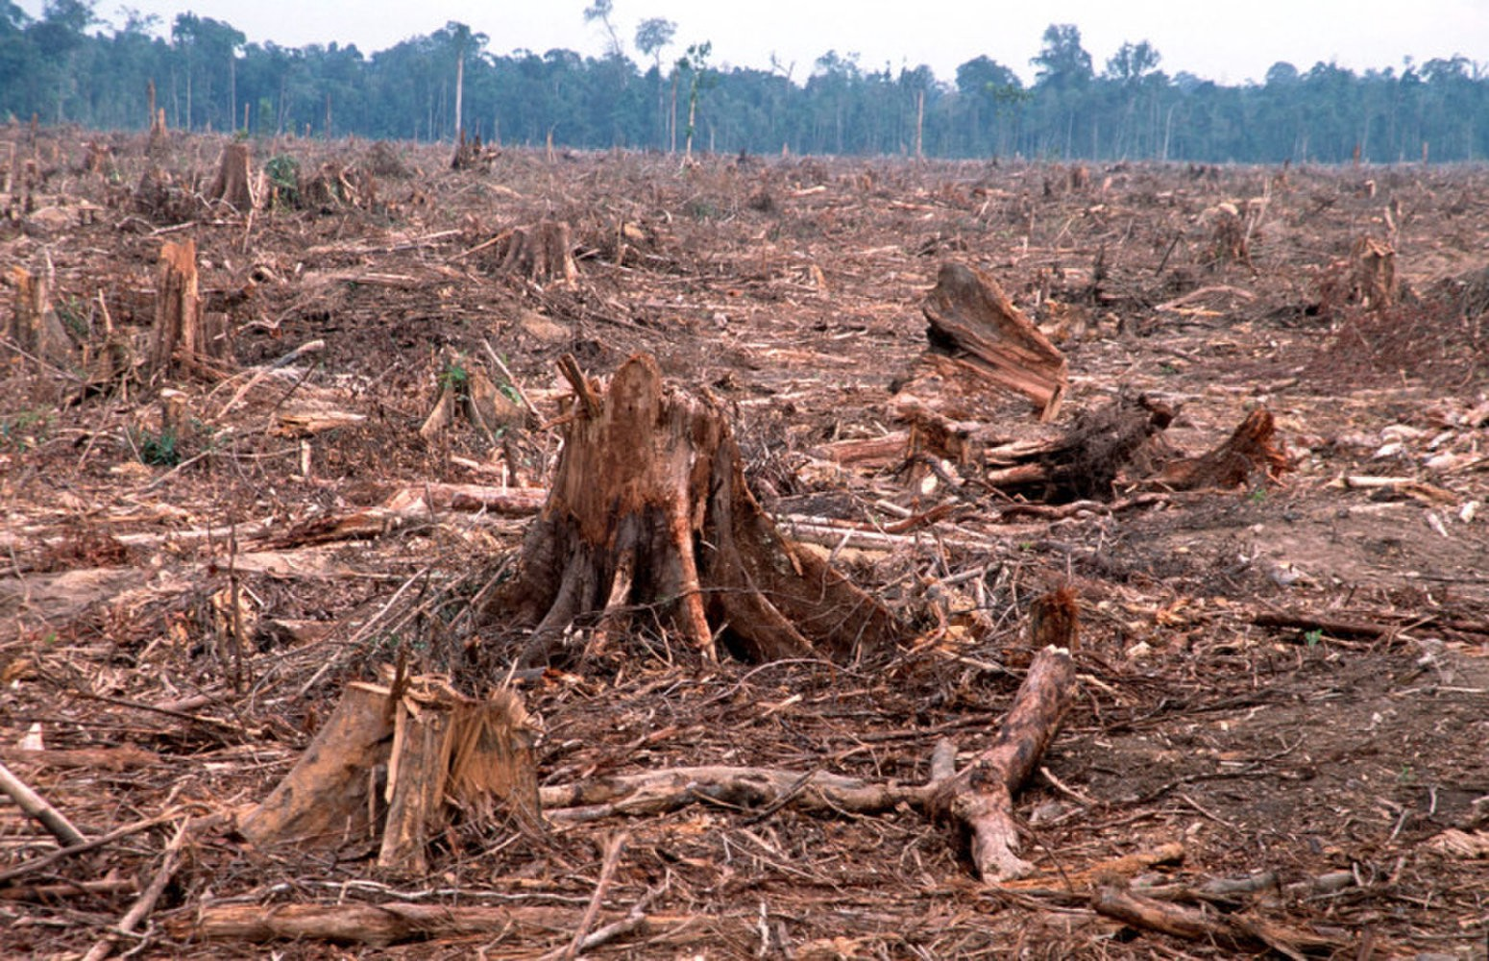
What is deforestation?
Deforestation is when forests are destroyed by cutting trees and not replanting them.

Slide 3
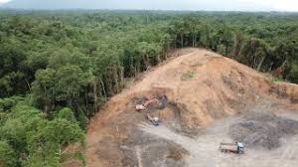
Types of deforestation
There’s two types of deforestation - Clear cutting and selective logging
Clear cutting occurs when most or all of an entire area is taken down
selective logging is when loggers only cut down the trees that are of use to them

Slide 4
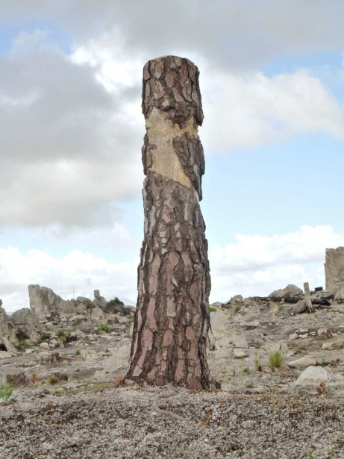
What are the effects of deforestation
Soil erosion destruction. Soils are exposed to the sun's heat
Water Cycle. When forests are destroyed, the atmosphere, water bodies, and the water table are all affected
Loss of Biodiversity
Climate Change

Slide 5
Ways to stop deforestation
Plant a Tree where you can.
Go paperless at home and in the office.
Buy recycled products and then recycle them again
Buy certified wood products
Support the products of companies that are committed to reducing deforestation

