Slide 1
Deforestation
The Facts
Jamie McCormick P7

Slide 2
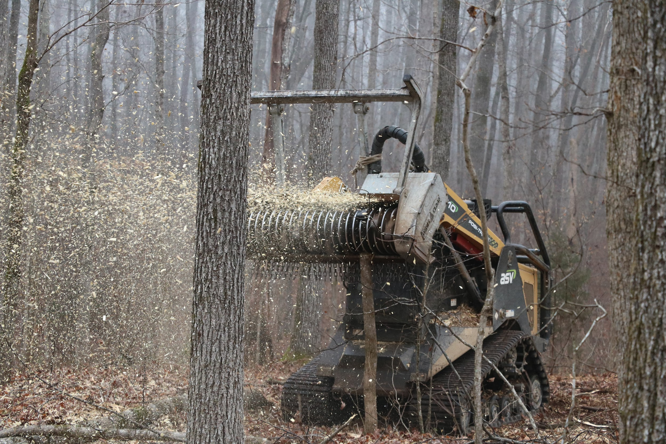
Contents
Contents:
What is deforestation?
Types of deforestation.
Effects of deforestation.
How to stop deforestation?

Slide 3
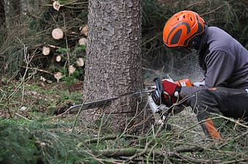
What Is Deforestation?
Deforestation is the removal of trees from land to make room for crops, cattle and homes.

Slide 4
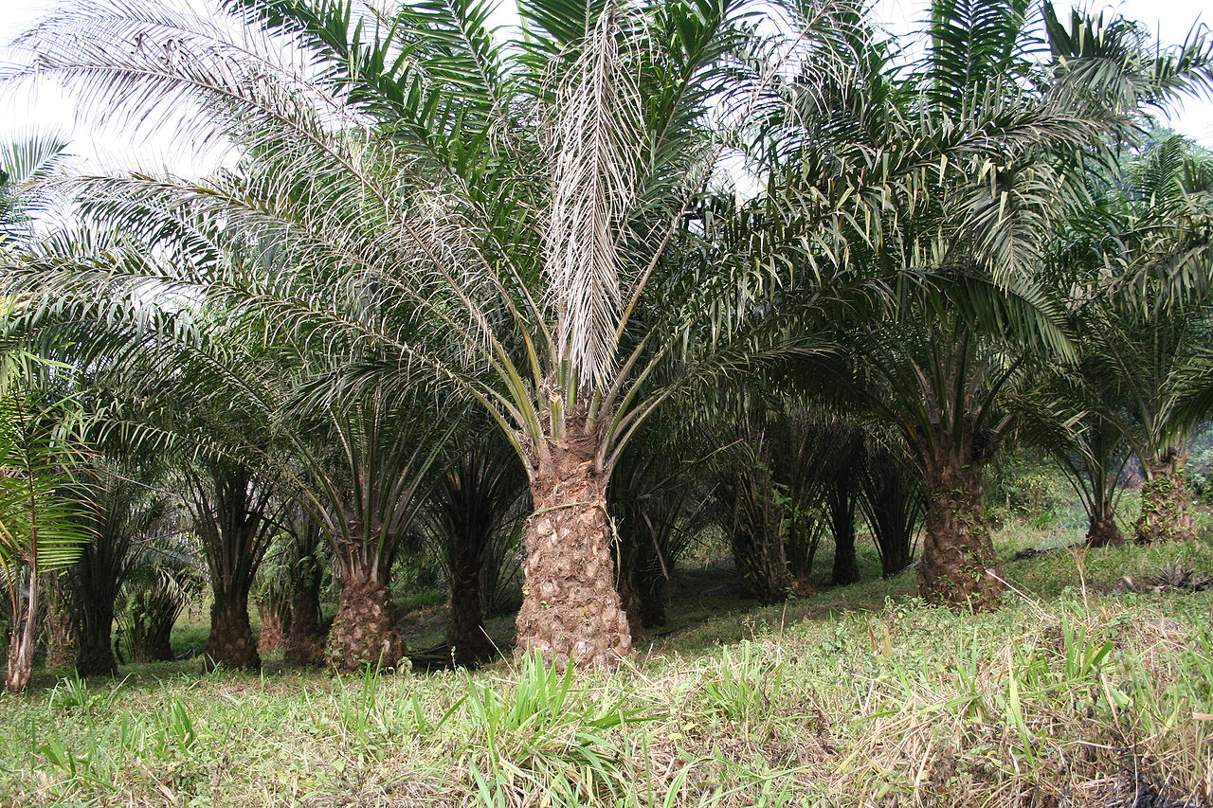
Types Of Deforestation.
Deforestation can sometimes have natural causes but is mostly man-made.
Natural: Floods, hurricanes, landslides, fires and storms.
Man Made: Slash and burn. Carried out by remote communities for farming.
Logging. Used for building materials, fuel.
Land clearing. For animals to graze of plant bigger crops

Slide 5
Effects of Deforestation
Soil Erosion: Removal of soil by wind and rain. Moisture, nutrients and the bacteria that break down dead vegetation are also lost because of the sunlight.
Water cycle: With less trees and plants water is lost to the atmosphere and rivers and small lakes start to dry up.
Loss of biodiversity: Animals that live in forests are dying because when the trees are taken away they struggle to find food and water. 80% of all living creatures live in forests.
Climate change: Trees and plants take in carbon dioxide and make oxygen. With less trees there will more carbon dioxide in the atmosphere making climate change worse.

Slide 6
How To Stop The Need For Deforestation
Make people know that deforestation is bad for the environment.
Plant trees to help fix damaged ecosystems
Live in a way that doesn’t hurt the environment and uses less wood
Makes forests protected areas.
Only buy from companies that try to look after the environment by planting trees.

