Slide 1
Deforestation
Evan McLaughlin P6

Slide 2
What is deforestation?
Deforestation is the removal of trees and forests from the landscape.

Slide 3
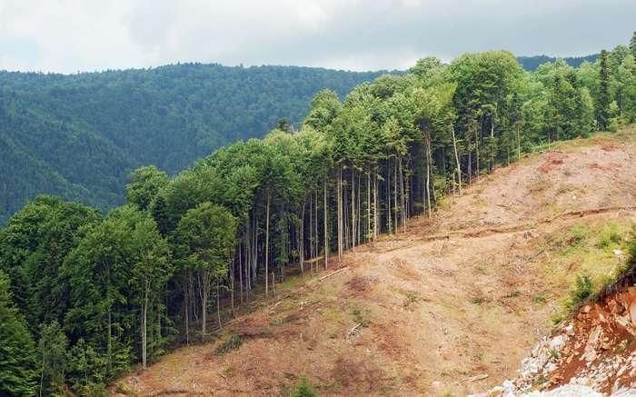
An image of deforestation in Romania

Slide 4
Why does deforestation happen?
To use the land for other uses e.g. agriculture.
To make products from the wood e.g. timber and paper.
To build houses and make roads.
Natural events such as forest fires and volcanic eruptions.

Slide 5
Effects of deforestation
Soil erosion - soil can be washed away by running water.
Floods - there are no trees, so there is no drainage.
Wildlife extinction - animals which live in forests and jungles lose their habitats.
Global warming - the water cycle is affected and there are more greenhouse gases.
Climate imbalance
Loss of indigenous tribes

Slide 6
The water cycle
Trees play a big part in the water cycle.
Water evaporates off their leaves during photosynthesis (how plants make food).
This is known as transpiration.

Slide 8
Deforestation statistics
36 football pitches of forest are lost each minute.
Up to 15 BILLION trees are cut down every year.
The total world forest loss is 7.3 MILLION hectares a year. This is roughly the size of Panama!
HALF

Slide 9
Important facts
Up to 28 thousand species are expected to become extinct by the next quarter of a century, due to deforestation.
Forests cover ¼ of all land surfaces on Earth.
Forests are vital for our health.
Rainforests cover only 6% of the world’s surface.

Slide 10
Important facts
More than 25% of medicines come from rainforest plants.
More than half of the timber and paper in the world are used by just 22% of the world’s population.
In 100 years, there may be no rainforest.
Trees give us Oxygen to breathe!

Slide 11
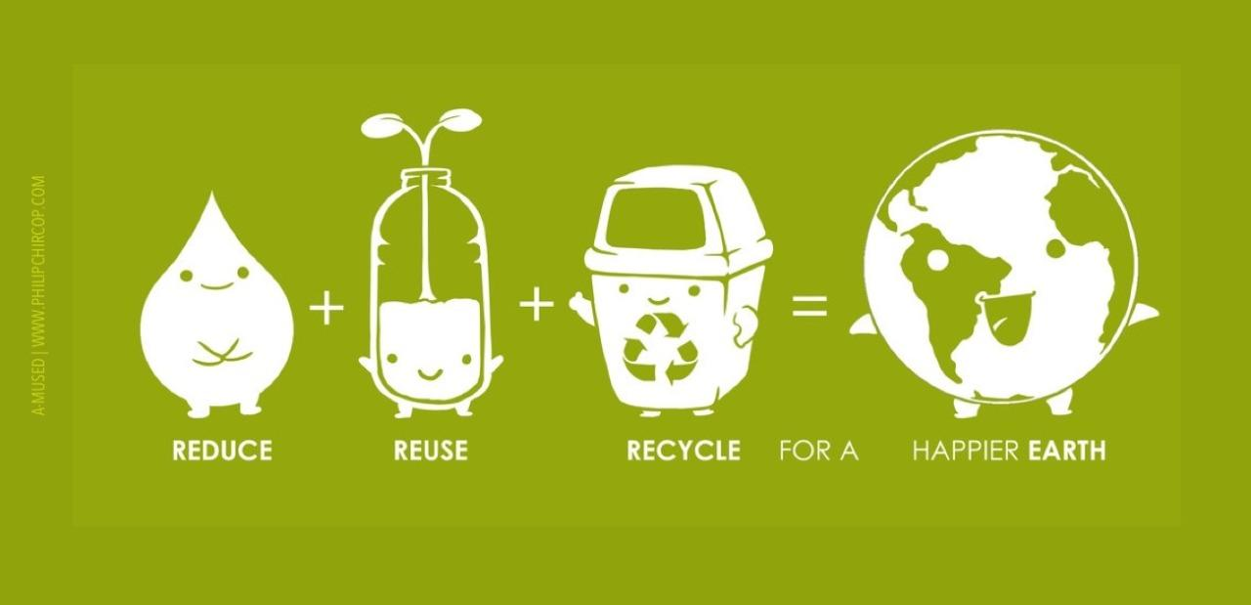
What can we do to help?

Slide 12
What can we do to help?
REDUCE - buy and use less products.
REUSE - reuse items and packaging we already have.
RECYCLE - recycle products correctly and only buy products in recyclable packaging.
Selective harvesting - only cut some trees, and leave others to grow in an area.
Protect areas

Slide 14
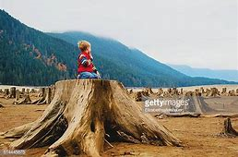
Save our trees, save our future…….

