Slide 1
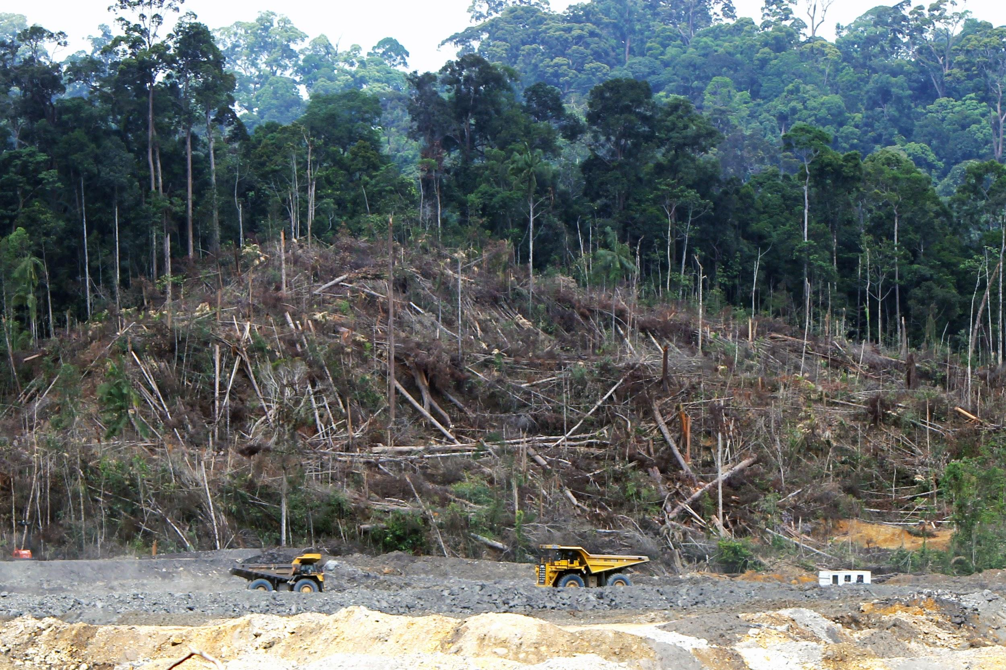
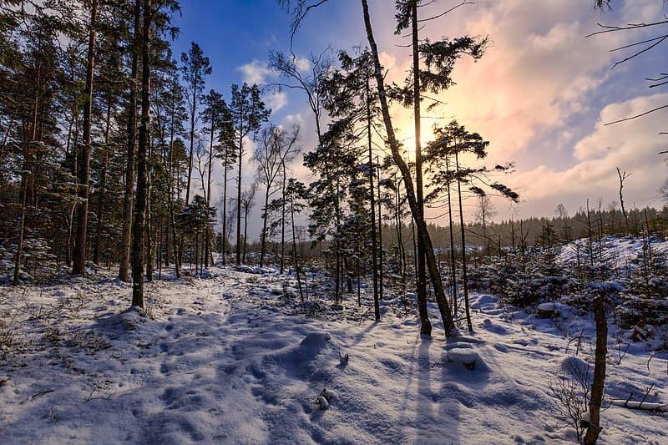
DEFORESTATION
Anna McGreevy P7

Slide 2
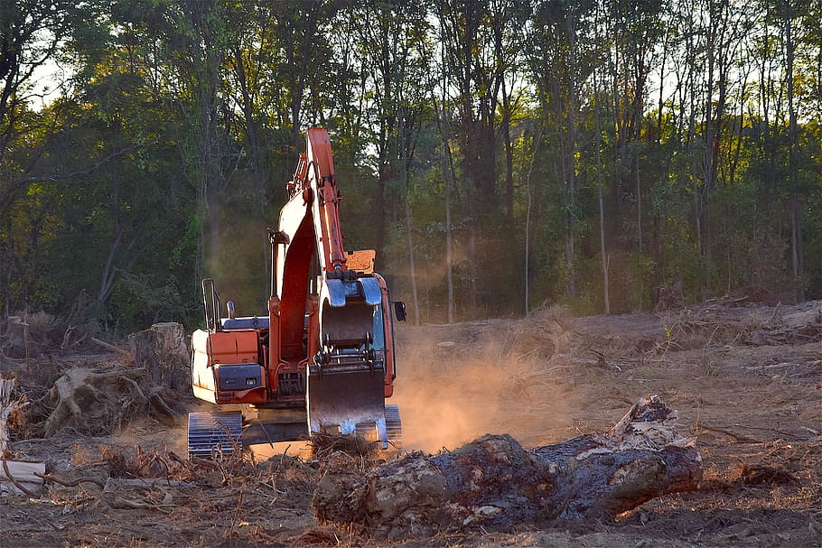
What is deforestation?
Deforestation is the permanent removal of trees to make room for something besides forests. This can include clearing the land for agriculture or grazing, or using the timber for fuel, construction or manufacturing.

Slide 3
Types of deforestation
Deforestation is the clearing, or cutting down, of forests. The word is normally used to describe the actions of humans in removing forests from the planet, rather than destruction caused by such natural events as hurricanes.
Slash and Burn
In some countries, especially in tropical areas and in Southeast Asia, farmers cut down large trees and then set fire to areas of a forest to kill off all the animals and plants living there. The ash from the fire helps to fertilize the land, and crops can be grown for a few years before the land becomes useless. The farmers then leave the area and move to a new place. This traditional method of deforestation is called slash and burn.
Forest plants and animals may return to the land, but it takes many years. Some places never recover.

Slide 4
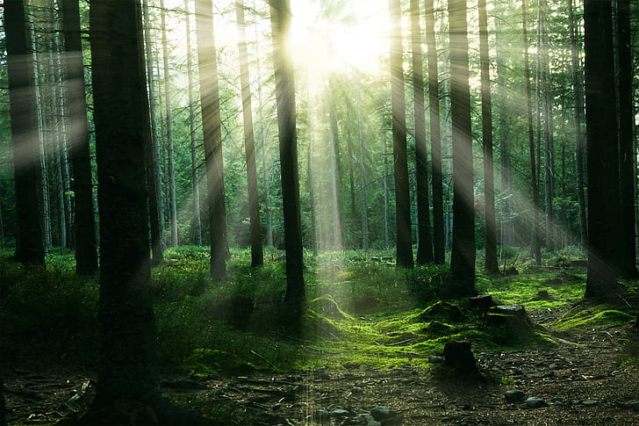
Effects of deforestation
Trees and other green plants produce oxygen, the gas needed by humans and other animals to live. When trees are cut down, less oxygen is released into the atmosphere.
Trees also capture carbon dioxide, one of the gases that contribute to a problem known as global warming. When they are burned, trees release carbon dioxide back into the atmosphere.

Slide 5
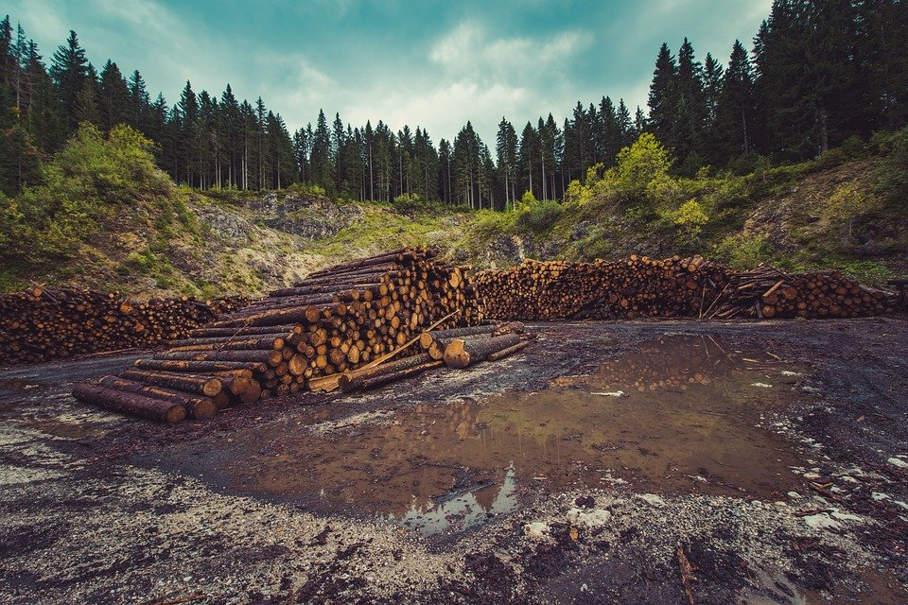
Logging
Large areas of forest are cut down by a process called logging. Machines or humans fell hundreds, or sometimes thousands, of trees and remove them for use as lumber.

Slide 6
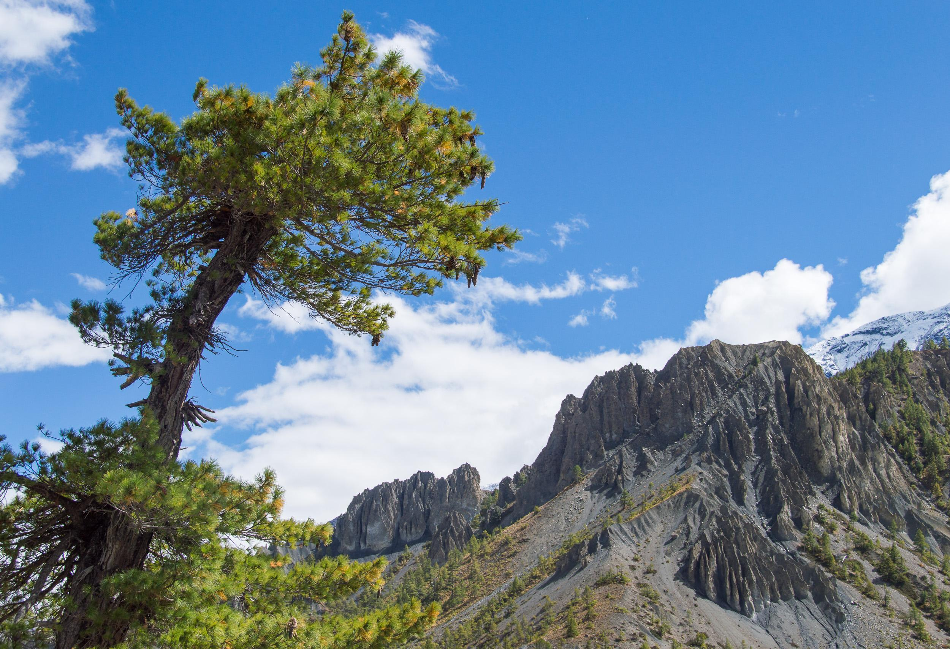
Erosion
Deforestation on steep mountain hillsides can lead to erosion. The land can get worn away because the trees are not there to hold the soil together. Heavy rains in such areas can wash the land down the slopes in disastrous landslides that destroy fields, homes, and human lives.

Slide 7
Habitat loss
Many forests are peaceful, quiet places where people can rest or play. When trees are cut down, this recreational use of forests is lost.
Forests are home to an enormous range of living things. When an area is deforested, many plants and animals are killed. Others lose their habitats. Some types of living things become extinct because of deforestation, especially those that live in tropical rainforests. The traditional way of life for rainforest peoples can be greatly affected by deforestation.

Slide 8
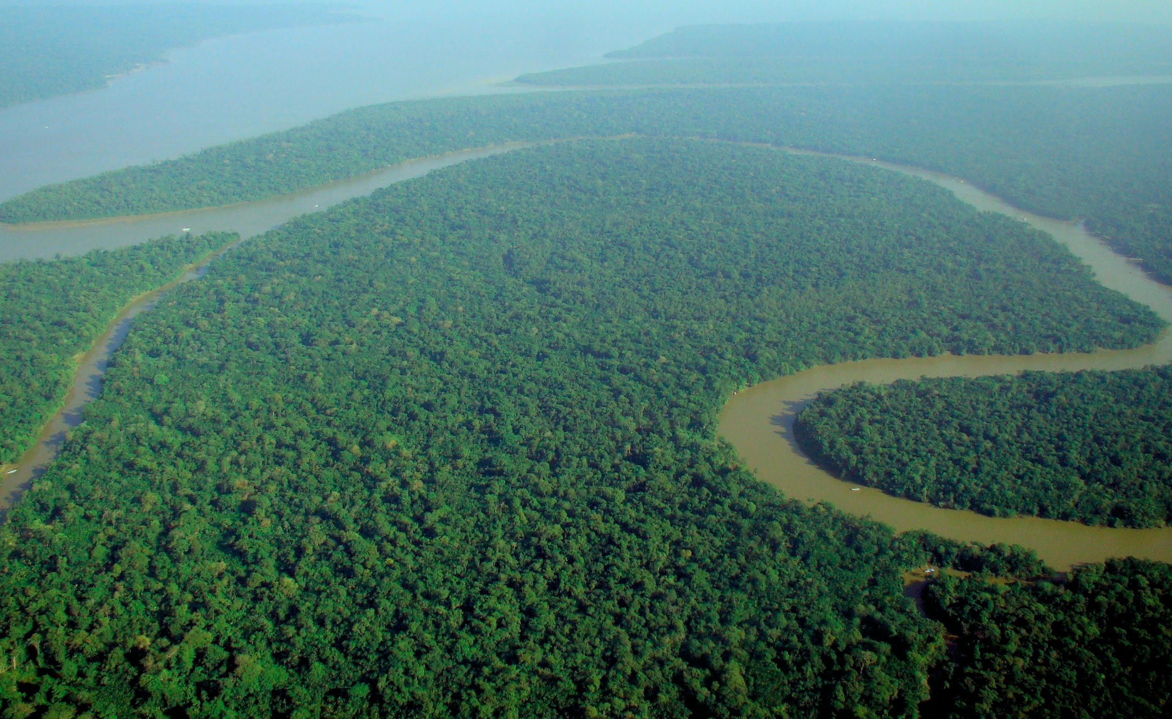
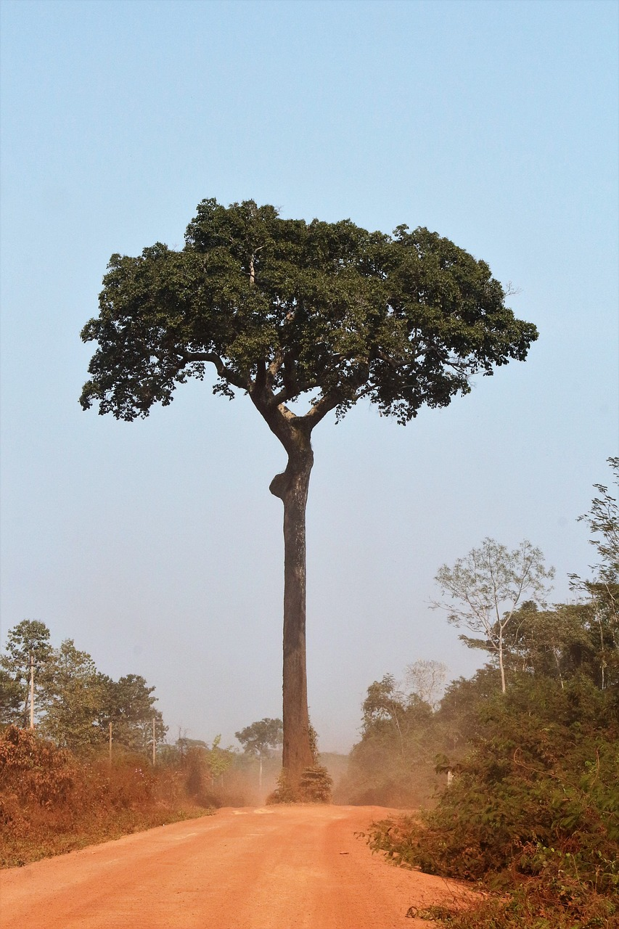
How to Reduce and Prevent Deforestation
Plant a tree.
Use less paper.
Recycle paper and cardboard.
Use recycled products.
Buy only sustainable wood products.
Don't buy products containing palm oil.
Reduce meat consumption.
Do not burn firewood excessively.

