Slide 1
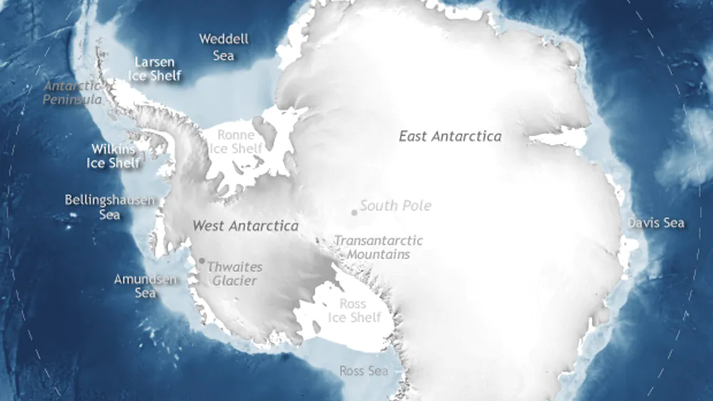
Antarctica- Fun Facts
Ryan Hamilton P6

Slide 2
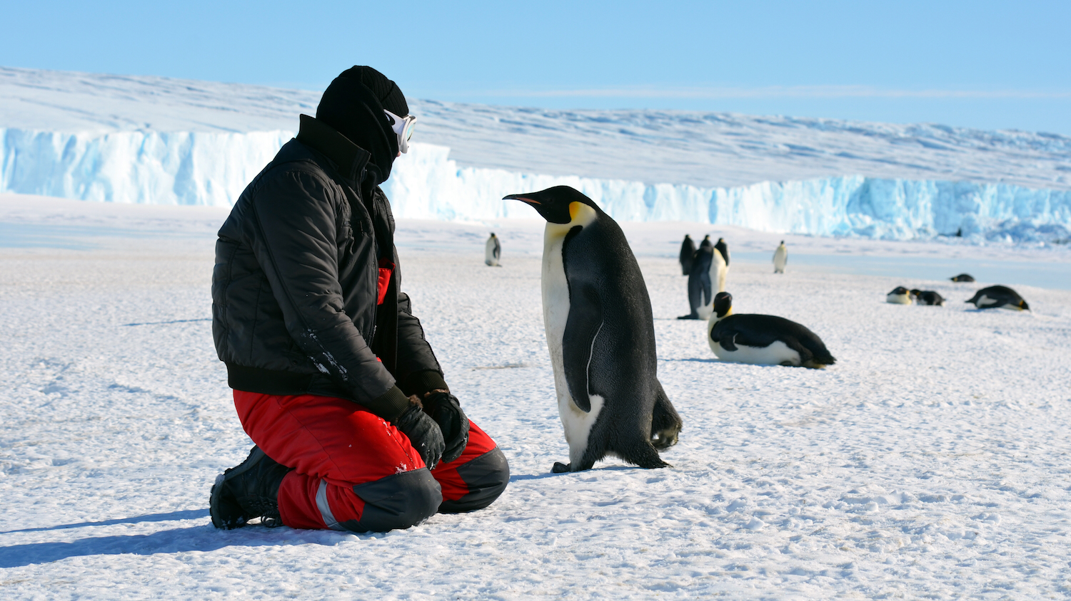
Antarctica- Fun Facts
It’s is the fifth largest continent of our planet.
It is an ice covered continent surrounded by the southern ocean.
It’s an icy desert with very little rainfall throughout the year.
It is the windiest place on Earth.
The Antarctic Treaty was signed by 53 countries in 1961.

Slide 3
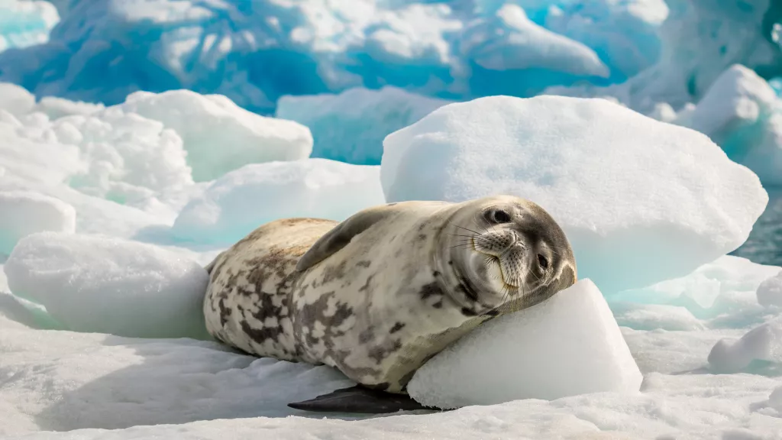
Antarctica- Fun Facts
18 countries regularly send scientists and researchers to stations on the continent.
It is the highest continent.
There are very few plants found in Antarctica.
Very little species live on Antarctica.
It’s the coldest continent of are planet.

Slide 4
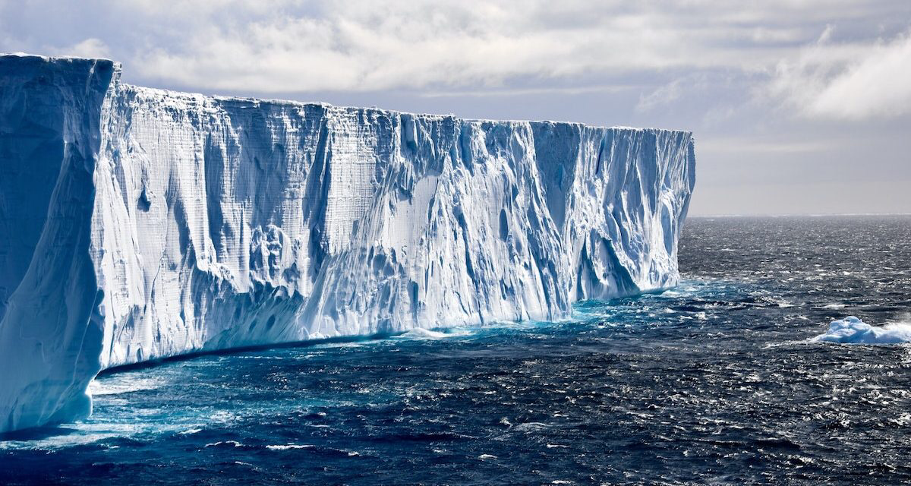
Antarctica- Fun Facts
British explorer James Cook was the to cross the Antarctic circle in 1773.
In 1985 Scientists discovered a huge ozone layer hole which grew in the atmosphere over Antarctica.
40,000 tourists visit Antarctica each year.
It contains 90% of the worlds ice and more than 90% of our planets freshwater.
That is where the South Pole is located.

